Slide 1
CS 290H: Sparse Matrix Algorithms
John R. Gilbert (gilbert@cs.ucsb.edu)
http://www.cs.ucsb.edu/~gilbert/cs290hFall2004

Slide 2
Some examples of sparse matrices
http://math.nist.gov/MatrixMarket/
http://www.cs.berkeley.edu/~madams/femarket/index.html
http://crd.lbl.gov/~xiaoye/SuperLU/SLU-Highlight.gif
http://www.cise.ufl.edu/research/sparse/matrices/

Slide 3
Link analysis of the web
1
2
3
4
5
6
7
1
2
1
2
3
4
7
5
4
5
6
3
6
7
Web page = vertex
Link = directed edge
Link matrix: A_{ij} = 1 if page i links to page j

Slide 4
Web graph: PageRank (Google) [Brin, Page]
An important page is one that many important pages point to.
Markov process: follow a random link most of the time;
otherwise, go to any page at random.
Importance = stationary distribution of Markov process.
Transition matrix is p*A + (1-p)*ones(size(A)),
scaled so each column sums to 1.
Importance of page i is the i-th entry in the principal eigenvector of the transition matrix.
But, the matrix is 2,000,000,000 by 2,000,000,000.

Slide 5
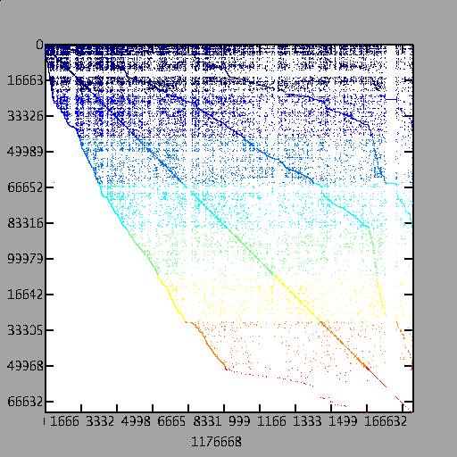
A Page Rank Matrix
Importance ranking
of web pages
Stationary distribution
of a Markov chain
Power method: matvec
and vector arithmetic
Matlab*P page ranking
demo (from SC’03) on
a web crawl of mit.edu
(170,000 pages)

Slide 6
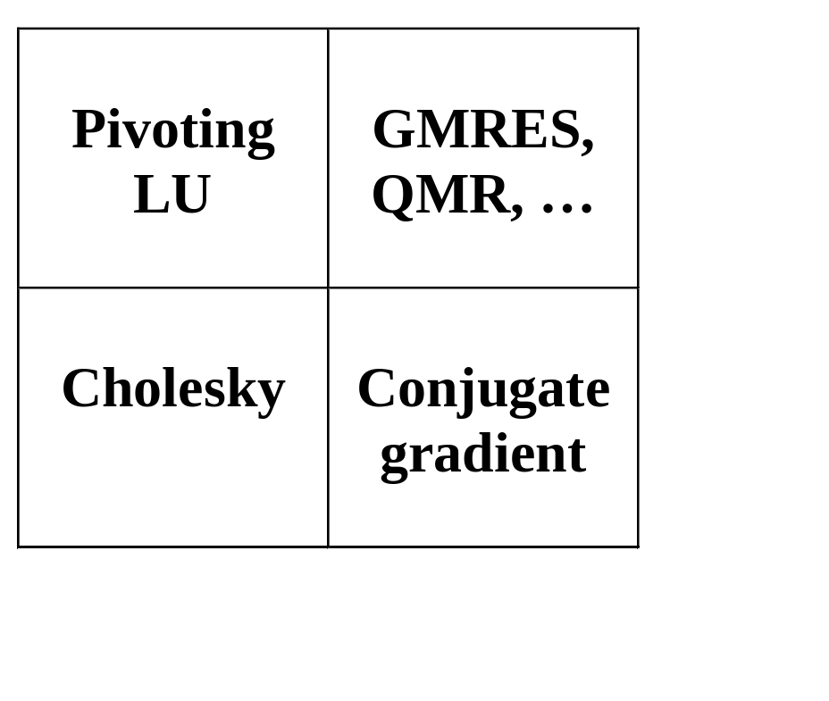
The Landscape of Sparse Ax=b Solvers
Direct
A = LU
Iterative
y’ = Ay
More General
Non-
symmetric
Symmetric
positive
definite
More Robust
More Robust
Less Storage
D

Slide 7
Matrix factorizations for linear equation systems
Cholesky factorization:
  R = chol(A);
  (Matlab: left-looking column algorithm)
Nonsymmetric LU with partial pivoting:
  [L,U,P] = lu(A);
  (Matlab: left-looking, depth-first search, symmetric pruning)
Orthogonal:
  [Q,R] = qr(A);
  (Matlab: George-Heath algorithm, row-wise Givens rotations)

Slide 8
Graphs and Sparse Matrices: Cholesky factorization
Fill: new nonzeros in factor
1
3
7
1
3
7
Symmetric Gaussian elimination:
for j = 1 to n
add edges between j’s
higher-numbered neighbors
8
6
8
6
4
10
4
10
9
5
2
9
5
2
G(A)
G⁺(A)
[chordal]

Slide 9
Sparse Cholesky factorization to solve Ax = b
Preorder: replace A by PAP^{T} and b by Pb
  Independent of numerics
Symbolic Factorization: build static data structure
  Elimination tree
  Nonzero counts
  Supernodes
  Nonzero structure of L
Numeric Factorization: A = LL^{T}
  Static data structure
  Supernodes use BLAS3 to reduce memory traffic
Triangular Solves: solve Ly = b, then L^{T}x = y

Slide 10
Complexity measures for sparse Cholesky
Space:
  Measured by fill, which is nnz(G⁺(A))
  Number of off-diagonal nonzeros in Cholesky factor; really you need to store n + nnz(G⁺(A)) real numbers.
  ~ sum over vertices of G⁺(A) of (# of larger neighbors).
Time:
  Measured by number of multiplicative flops (* and /)
  ~ sum over vertices of G⁺(A) of (# of larger neighbors)^2

Slide 11
Path lemma (GLN Theorem 4.2.2)
Let G = G(A) be the graph of a symmetric, positive definite matrix, with vertices 1, 2, …, n, and let G⁺ = G⁺(A) be the filled graph.
Then (v, w) is an edge of G⁺ if and only if G contains a path from v to w of the form (v, x₁, x₂, …, x_{k}, w) with
x_{i} < min(v, w) for each i.
(This includes the possibility k = 0, in which case (v, w) is an edge of G and therefore of G⁺.)

Slide 12
The (2-dimensional) model problem
n^{1/2}
Graph is a regular square grid with n = k^2 vertices.
Corresponds to matrix for regular 2D finite difference mesh.
Gives good intuition for behavior of sparse matrix algorithms on many 2-dimensional physical problems.
There’s also a 3-dimensional model problem.

Slide 13
Permutations of the 2-D model problem
Theorem: With the natural permutation, the n-vertex model problem has Θ(n^{3/2}) fill.
Theorem: With any permutation, the n-vertex model problem has Ω(n log n) fill.
Theorem: With a nested dissection permutation, the
n-vertex model problem has O(n log n) fill.

Slide 14
Nested dissection ordering
A separator in a graph G is a set S of vertices whose removal leaves at least two connected components.
A nested dissection ordering for an n-vertex graph G numbers its vertices from 1 to n as follows:
  Find a separator S, whose removal leaves connected components T₁, T₂, …, T_{k}
  Number the vertices of S from n-|S|+1 to n.
  Recursively, number the vertices of each component:
  T₁ from 1 to |T₁|, T₂ from |T₁|+1 to |T₁|+|T₂|, etc.
  If a component is small enough, number it arbitrarily.
It all boils down to finding good separators!

Slide 15
Separators in theory
If G is a planar graph with n vertices, there exists a set of at most sqrt(6n) vertices whose removal leaves no connected component with more than 2n/3 vertices.
(“Planar graphs have sqrt(n)-separators.”)
“Well-shaped” finite element meshes in 3 dimensions have n^{2/3} - separators.
Also some other classes of graphs – trees, graphs of bounded genus, chordal graphs, bounded-excluded-minor graphs, …
Mostly these theorems come with efficient algorithms, but they aren’t used much.

Slide 16
Separators in practice
Graph partitioning heuristics have been an active research area for many years, often motivated by partitioning for parallel computation. See CS 240A.
Some techniques:
  Spectral partitioning (uses eigenvectors of Laplacian matrix of graph)
  Geometric partitioning (for meshes with specified vertex coordinates)
  Iterative-swapping (Kernighan-Lin, Fiduccia-Matheysses)
  Breadth-first search (GLN 7.3.3, fast but dated)
Many popular modern codes (e.g. Metis, Chaco) use multilevel iterative swapping
Matlab graph partitioning toolbox: see course web page

Slide 17
Heuristic fill-reducing matrix permutations
Nested dissection:
  Find a separator, number it last, proceed recursively
  Theory: approx optimal separators => approx optimal fill and flop count
  Practice: often wins for very large problems
Minimum degree:
  Eliminate row/col with fewest nzs, add fill, repeat
  Hard to implement efficiently – current champion is
  “Approximate Minimum Degree” [Amestoy, Davis, Duff]
  Theory: can be suboptimal even on 2D model problem
  Practice: often wins for medium-sized problems
Banded orderings (Reverse Cuthill-McKee, Sloan, . . .):
  Try to keep all nonzeros close to the diagonal
  Theory, practice: often wins for “long, thin” problems
The best modern general-purpose orderings are ND/MD hybrids.

Slide 18
Fill-reducing permutations in Matlab
Symmetric approximate minimum degree:
  p = symamd(A);
  symmetric permutation: chol(A(p,p)) often sparser than chol(A)
Symmetric nested dissection:
  not built into Matlab
  several versions in meshpart toolbox (course web page references)
Nonsymmetric approximate minimum degree:
  p = colamd(A);
  column permutation: lu(A(:,p)) often sparser than lu(A)
  also for QR factorization
Reverse Cuthill-McKee
  p = symrcm(A);
  A(p,p) often has smaller bandwidth than A
  similar to Sparspak RCM

Slide 19
Sparse matrix data structures (one example)
31 | 41 | 59 | 26 | 53
31 | 0 | 53
0 | 59 | 0
41 | 26 | 0
1 | 3 | 2 | 3 | 1
Full:
  2-dimensional array of real or complex numbers
  (nrows*ncols) memory
Sparse:
  compressed column storage (CSC)
  about (1.5*nzs + .5*ncols) memory

Slide 20
Matrix – matrix multiplication: C = A * B
C(:, :) = 0;
for i = 1:n
for j = 1:n
for k = 1:n
C(i, j) = C(i, j) + A(i, k) * B(k, j);
The n^3 scalar updates can be done in any order.
Six possible algorithms: ijk, ikj, jik, jki, kij, kji
(lots more if you think about blocking for cache)

Slide 21
Organizations of matrix multiplication
How to do it in O(flops) time?
- How insert updates fast enough?
- How avoid Θ(n²) loop iterations?
Loop k only over nonzeros in column j of B
Sparse accumulator
outer product:
for k = 1:n
C = C + A(:, k) * B(k, :)
inner product:
for i = 1:n
for j = 1:n
C(i, j) = A(i, :) * B(:, j)
column by column:
for j = 1:n
for k = 1:n
C(:, j) = C(:, j) + A(:, k) * B(k, j)

Slide 22
Sparse accumulator (SPA)
Abstract data type for a single sparse matrix column
Operations:
  initialize spa O(n) time & O(n) space
  spa = spa + (scalar) * (CSC vector) O(nnz(spa)) time
  (CSC vector) = spa O(nnz(spa)) time (***)
  spa = 0 O(nnz(spa)) time
  … possibly other ops

Slide 23
Sparse accumulator (SPA)
Abstract data type for a single sparse matrix column
Operations:
  initialize spa O(n) time & O(n) space
  spa = spa + (scalar) * (CSC vector) O(nnz(spa)) time
  (CSC vector) = spa O(nnz(spa)) time (***)
  spa = 0 O(nnz(spa)) time
  … possibly other ops
Implementation:
  dense n-element floating-point array “value”
  dense n-element boolean (***) array “is-nonzero”
  linked structure to sequence through nonzeros (***)
  (***) many possible variations in details

Slide 24
Column Cholesky Factorization
for j = 1 : n
for k = 1 : j -1
% cmod(j,k)
for i = j : n
A(i, j) = A(i, j) – A(i, k)*A(j, k);
end;
end;
% cdiv(j)
A(j, j) = sqrt(A(j, j));
for i = j+1 : n
A(i, j) = A(i, j) / A(j, j);
end;
end;
j
L^{T}
L
A
L
Column j of A becomes column j of L

Slide 25
Sparse Column Cholesky Factorization
for j = 1 : n
L(j:n, j) = A(j:n, j);
for k < j with L(j, k) nonzero
% sparse cmod(j,k)
L(j:n, j) = L(j:n, j) – L(j, k) * L(j:n, k);
end;
% sparse cdiv(j)
L(j, j) = sqrt(L(j, j));
L(j+1:n, j) = L(j+1:n, j) / L(j, j);
end;
j
L^{T}
L
A
L
Column j of A becomes column j of L

Slide 26
Elimination Tree
1
3
7
10
9
8
6
5
4
8
4
2
10
7
6
3
9
5
2
1
Cholesky factor
G⁺(A)
T(A)
T(A) : parent(j) = min { i > j : (i, j) in G⁺(A) }
parent(col j) = first nonzero row below diagonal in L
T describes dependencies among columns of factor
Can compute G⁺(A) easily from T
Can compute T from G(A) in almost linear time

Slide 27
Facts about elimination trees
If G(A) is connected, then T(A) is connected
(it’s a tree, not a forest).
If A(i, j) is nonzero and i > j, then i is an ancestor of j in T(A).
If L(i, j) is nonzero, then i is an ancestor of j in T(A).
T(A) is a depth-first spanning tree of G⁺(A).
T(A) is the transitive reduction of the directed graph G(L^{T}).

Slide 28
Describing the nonzero structure of L in terms of G(A) and T(A)
If (i, k) is an edge of G with i > k, [GLN 6.2.1]
then the edges of G⁺ include:
(i, k) ; (i, p(k)) ; (i, p(p(k))) ; (i, p(p(p(k)))) . . .
Let i > j. Then (i, j) is an edge of G⁺ iff j is an ancestor in T of some k such that (i, k) is an edge of G. [GLN 6.2.3]
The nonzeros in row i of L are a “row subtree” of T.
The nonzeros in col j of L are some of j’s ancestors in T.
  Just the ones adjacent in G to vertices in the subtree of T rooted at j.

Slide 29
Nested dissection fill bounds
Theorem: With a nested dissection ordering using sqrt(n)-separators, any n-vertex planar graph has O(n log n) fill.
  We’ll prove this assuming bounded vertex degree, but it’s true anyway.
Corollary: With a nested dissection ordering, the n-vertex model problem has O(n log n) fill.
Theorem: If a graph and all its subgraphs have O(nª)-separators for some a >1/2, then it has an ordering with O(n^{2a}) fill.
  With a = 2/3, this applies to well-shaped 3-D finite element meshes
In all these cases factorization time, or flop count, is O(n^{3a}).

Slide 30
Complexity of direct methods
Time and space to solve any problem on any well-shaped finite element mesh
n^{1/2}
n^{1/3}
 | 2D | 3D
Space (fill): | O(n log n) | O(n ^{4/3} )
Time (flops): | O(n ^{3/2} ) | O(n ² )

Slide 31
Finding the elimination tree efficiently
Given the graph G = G(A) of n-by-n matrix A
start with an empty forest (no vertices)
for i = 1 : n
add vertex i to the forest
for each edge (i, j) of G with i > j
make i the parent of the root of the tree containing j
Implementation uses a disjoint set union data structure
for vertices of subtrees [GLN Algorithm 6.3 does this explicitly]
Running time is O(nnz(A) * inverse Ackermann function)
In practice, we use an O(nnz(A) * log n) implementation

Slide 32
Symbolic factorization: Computing G⁺(A)
T and G give the nonzero structure of L either by rows or by columns.
Row subtrees [GLN Figure 6.2.5]: Tr[i] is the subtree of T formed by
the union of the tree paths from j to i, for all edges (i, j) of G with j < i.
  Tr[i] is rooted at vertex i.
  The vertices of Tr[i] are the nonzeros of row i of L.
  For j < i, (i, j) is an edge of G⁺ iff j is a vertex of Tr[i].
Column unions [GLN Thm 6.1.5]: Column structures merge up the tree.
  struct(L(:, j)) = struct(A(j:n, j)) + union( struct(L(:,k)) | j = parent(k) in T )
  For i > j, (i, j) is an edge of G⁺ iff
  either (i, j) is an edge of G
  or (i, k) is an edge of G⁺ for some child k of j in T.
Running time is O(nnz(L)), which is best possible . . .
. . . unless we just want the nonzero counts of the rows and columns of L

Slide 33
Finding row and column counts efficiently
First ingredient: number the elimination tree in postorder
  Every subtree gets consecutive numbers
  Renumbers vertices, but does not change fill or edges of G+
Second ingredient: fast least-common-ancestor algorithm
  lca (u, v) = root of smallest subtree containing both u and v
  In a tree with n vertices, can do m arbitrary lca() computations
  in time O(m * inverse Ackermann(m, n))
  The fast lca algorithm uses a disjoint-set-union data structure

Slide 34
Row counts [GLN Algorithm 6.12]
RowCnt(u) is # vertices in row subtree Tr[u].
Third ingredient: path decomposition of row subtrees
Lemma: Let p₁ < p₂ < … < p_{k} be some of the vertices of a postordered tree, including all the leaves and the root. Let q_{i} = lca(p_{i} , p_{i+1}) for each i < k. Then each edge of the tree is on the tree path from p_{j} to q_{j} for exactly one j.
Lemma applies if the tree is Tr[u] and p₁, p₂, …, p_{k} are the nonzero column numbers in row u of A.
RowCnt(u) = 1 + sum_{i} ( level(p_{i}) – level( lca(p_{i} , p_{i+1}) )
Algorithm computes all lca’s and all levels, then evaluates the sum above for each u.
Total running time is O(nnz(A) * inverse Ackermann)

Slide 35
Column counts [GLN Algorithm 6.14]
ColCnt(v) is computed recursively from children of v.
Fourth ingredient: weights or “deltas” give difference between v’s ColCnt and sum of children’s ColCnts.
Can compute deltas from least common ancestors.
See GLN (or paper to be handed out) for details
Total running time is O(nnz(A) * inverse Ackermann)

Slide 36
Symmetric positive definite systems: A=LL^{T}
Preorder
  Independent of numerics
Symbolic Factorization
  Elimination tree
  Nonzero counts
  Supernodes
  Nonzero structure of R
Numeric Factorization
  Static data structure
  Supernodes use BLAS3 to reduce memory traffic
Triangular Solves
}
O(#nonzeros in A), almost
O(#nonzeros in L)
O(#flops)
Result:
  Modular => Flexible
  Sparse ~ Dense in terms of time/flop

Slide 37
Triangular solve: x = L \ b
Row oriented:
for i = 1 : n
x(i) = b(i);
for j = 1 : (i-1)
x(i) = x(i) – L(i, j) * x(j);
end;
x(i) = x(i) / L(i, i);
end;
Column oriented:
x(1:n) = b(1:n);
for j = 1 : n
x(j) = x(j) / L(j, j);
x(j+1:n) = x(j+1:n) –
L(j+1:n, j) * x(j);
end;
Either way works in O(nnz(L)) time
If b and x are dense, flops = nnz(L) so no problem
If b and x are sparse, how do it in O(flops) time?

Slide 38
Directed Graph
1
2
4
7
5
3
6
A
G(A)
A is square, unsymmetric, nonzero diagonal
Edges from rows to columns
Symmetric permutations PAP^{T}

Slide 39
Directed Acyclic Graph
1
2
4
7
5
3
6
A
G(A)
If A is triangular, G(A) has no cycles
Lower triangular => edges from higher to lower #s
Upper triangular => edges from lower to higher #s

Slide 40
Directed Acyclic Graph
1
2
4
7
5
3
6
A
G(A)
If A is triangular, G(A) has no cycles
Lower triangular => edges from higher to lower #s
Upper triangular => edges from lower to higher #s

Slide 41
Depth-first search and postorder
dfs (starting vertices)
marked(1 : n) = false;
p = 1;
for each starting vertex v do visit(v);
visit (v)
if marked(v) then return;
marked(v) = true;
for each edge (v, w) do
visit(w);
postorder(v) = p; p = p + 1;
When G is acyclic, postorder(v) > postorder(w)
for every edge (v, w)

Slide 42
Depth-first search and postorder
dfs (starting vertices)
marked(1 : n) = false;
p = 1;
for each starting vertex v do
if not marked(v) then visit(v);
visit (v)
marked(v) = true;
for each edge (v, w) do
if not marked(w) then visit(w);
postorder(v) = p; p = p + 1;
When G is acyclic, postorder(v) > postorder(w)
for every edge (v, w)

Slide 43
Sparse Triangular Solve
1
1
2
3
4
5
=
2
3
5
4
L
x
b
G(L^{T})
Symbolic:
  Predict structure of x by depth-first search from nonzeros of b
Numeric:
  Compute values of x in topological order
Time = O(flops)

Slide 44
Sparse-sparse triangular solve: x = L \ b
Column oriented:
dfs in G(L^{T}) to predict nonzeros of x;
x(1:n) = b(1:n);
for j = nonzero indices of x in topological order
x(j) = x(j) / L(j, j);
x(j+1:n) = x(j+1:n) – L(j+1:n, j) * x(j);
end;
Depth-first search calls “visit” once per flop
Runs in O(flops) time even if it’s less than nnz(L) or n …
Except for one-time O(n) SPA setup

Slide 45
Structure prediction for sparse solve
1
2
=
4
7
5
3
6
A
x
b
G(A)
Given the nonzero structure of b, what is the structure of x?
Vertices of G(A) from which there is a path to a vertex of b.

Slide 46
Nonsymmetric Gaussian elimination
A = LU: does not always exist, can be unstable
PA = LU: Partial pivoting
  At each elimination step, pivot on largest-magnitude element in column
  “GEPP” is the standard algorithm for dense nonsymmetric systems
PAQ = LU: Complete pivoting
  Pivot on largest-magnitude element in the entire uneliminated matrix
  Expensive to search for the pivot
  No freedom to reorder for sparsity
  Hardly ever used in practice
Conflict between permuting for sparsity and for numerics
  Lots of different approaches to this tradeoff; we’ll look at a few

Slide 47
Symbolic sparse Gaussian elimination: A = LU
1
2
4
7
5
3
6
A
+
L+U
G (A)
Add fill edge a -> b if there is a path from a to b through lower-numbered vertices.
But this doesn’t work with numerical pivoting!

Slide 48
Nonsymmetric Ax = b:
Gaussian elimination with partial pivoting
P
=
x
PA = LU
Sparse, nonsymmetric A
Rows permuted by partial pivoting
Columns may be preordered for sparsity

Slide 49
Modular Left-looking LU
Alternatives:
  Right-looking Markowitz [Duff, Reid, . . .]
  Unsymmetric multifrontal [Davis, . . .]
  Symmetric-pattern methods [Amestoy, Duff, . . .]
Complications:
  Pivoting => Interleave symbolic and numeric phases
    Preorder Columns
    Symbolic Analysis
    Numeric and Symbolic Factorization
    Triangular Solves
  Lack of symmetry => Lots of issues . . .

Slide 50
Symmetric A implies G⁺(A) is chordal,
with lots of structure and elegant theory
For unsymmetric A, things are not as nice
No known way to compute G⁺(A) faster than
Gaussian elimination
No fast way to recognize perfect elimination graphs
No theory of approximately optimal orderings
Directed analogs of elimination tree:
Smaller graphs that preserve path structure

Slide 51
Left-looking Column LU Factorization
j
for column j = 1 to n do
  solve
  pivot: swap u_{jj} and an elt of l_{j}
  scale: l_{j} = l_{j} / u_{jj}
U
( )
( )
L 0
L I
u_{j}
l_{j}
L
= a_{j} for u_{j}, l_{j}
A
L
Column j of A becomes column j of L and U

Slide 52
Left-looking sparse LU with partial pivoting (I)
L = speye(n);
for column j = 1 : n
dfs in G(L^{T}) to predict nonzeros of x;
x(1:n) = a(1:n);
for j = nonzero indices of x in topological order
x(j) = x(j) / L(j, j);
x(j+1:n) = x(j+1:n) – L(j+1:n, j) * x(j);
U(1:j, j) = x(1:j);
L(j+1:n, j) = x(j+1:n);
pivot: swap U(j, j) and an element of L(:, j);
cdiv: L(j+1:n, j) = L(j+1:n, j) / U(j, j);

Slide 53
GP Algorithm [Matlab 4]
Left-looking column-by-column factorization
Depth-first search to predict structure of each column
+: Symbolic cost proportional to flops
-: Big constant factor – symbolic cost still dominates
=> Prune symbolic representation

Slide 54
Symmetric Pruning [Eisenstat, Liu]
Idea: Depth-first search in a sparser graph with the same path structure
r
j
k
Symmetric pruning:
Set L_{sr}=0 if L_{jr}U_{rj} ≠ 0
Justification:
A_{sk} will still fill in
r
= fill
j
= pruned
= nonzero
s
Use (just-finished) column j of L to prune earlier columns
No column is pruned more than once
The pruned graph is the elimination tree if A is symmetric

Slide 55
Left-looking sparse LU with partial pivoting (II)
L = speye(n); S = empty n-vertex graph;
for column j = 1 : n
dfs in S to predict nonzeros of x;
x(1:n) = a(1:n);
for j = nonzero indices of x in topological order
x(j) = x(j) / L(j, j);
x(j+1:n) = x(j+1:n) – L(j+1:n, j) * x(j);
U(1:j, j) = x(1:j);
L(j+1:n, j) = x(j+1:n);
pivot: swap U(j, j) and an element of L(:, j);
cdiv: L(j+1:n, j) = L(j+1:n, j) / U(j, j);
update S: add edges (j, i) for nonzero L(i, j);
prune

Slide 56
GP-Mod Algorithm [Matlab 5]
Left-looking column-by-column factorization
Depth-first search to predict structure of each column
Symmetric pruning to reduce symbolic cost
+: Much cheaper symbolic factorization than GP (~4x)
-: Indirect addressing for each flop (sparse vector kernel)
-: Poor reuse of data in cache (BLAS-1 kernel)
=> Supernodes

Slide 57
Symmetric supernodes for Cholesky [GLN section 6.5]
Supernode = group of adjacent columns of L with same nonzero structure
Related to clique structure
of filled graph G⁺(A)
{
Supernode-column update: k sparse vector ops become
1 dense triangular solve
+ 1 dense matrix * vector
+ 1 sparse vector add
Sparse BLAS 1 => Dense BLAS 2
Only need row numbers for first column in each supernode
For model problem, integer storage for L is O(n) not O(n log n)

Slide 58
Nonsymmetric Supernodes
1
1
2
2
3
3
4
4
5
5
6
6
7
7
8
8
9
9
10
10
Original matrix A
Factors L+U

Slide 59
Supernode-Panel Updates
j
j+w-1
for each panel do
  Symbolic factorization:
  which supernodes update the panel;
  Supernode-panel update:
  for each updating supernode do
    for each panel column do
    supernode-column update;
  Factorization within panel:
  use supernode-column algorithm
}
}
supernode
panel
+: “BLAS-2.5” replaces BLAS-1
-: Very big supernodes don’t fit in cache
=> 2D blocking of supernode-column updates

Slide 60
Sequential SuperLU
Depth-first search, symmetric pruning
Supernode-panel updates
1D or 2D blocking chosen per supernode
Blocking parameters can be tuned to cache architecture
Condition estimation, iterative refinement, componentwise error bounds

Slide 61
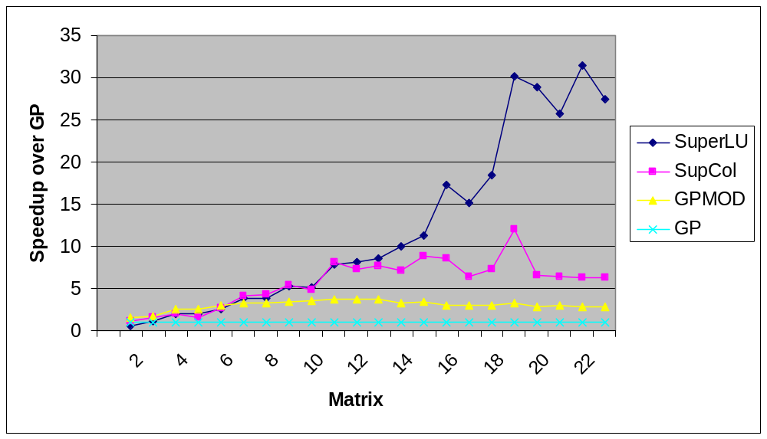
SuperLU: Relative Performance
Speedup over GP column-column
22 matrices: Order 765 to 76480; GP factor time 0.4 sec to 1.7 hr
SGI R8000 (1995)

Slide 62
Nonsymmetric Ax = b:
Gaussian elimination with partial pivoting
P
=
x
PA = LU
Sparse, nonsymmetric A
Rows permuted by partial pivoting
Columns may be preordered for sparsity

Slide 63
Column Intersection Graph
1
2
3
4
5
1
2
3
4
5
3
1
2
4
5
3
4
5
1
2
A
A^{T}A
G∩(A)
G∩(A) = G(A^{T}A) if no cancellation (otherwise ⊇)
Permuting the rows of A does not change G∩(A)

Slide 64
Filled Column Intersection Graph
1
2
3
4
5
1
2
3
4
5
3
1
2
4
5
3
4
5
1
2
A
chol(A^{T}A)
+
G∩(A)
G∩(A) = symbolic Cholesky factor of A^{T}A
In PA=LU, G(U) ⊆ G∩(A) and G(L) ⊆ G∩(A)
Tighter bound on L from symbolic QR
Bounds are best possible if A is strong Hall
+
+
+

Slide 65
Column Elimination Tree
5
1
2
3
4
5
1
2
3
4
5
1
4
2
3
2
3
4
5
1
A
chol(A^{T}A)
T∩(A)
Elimination tree of A^{T}A (if no cancellation)
Depth-first spanning tree of G∩(A)
Represents column dependencies in various factorizations
+

Slide 66
Efficient Structure Prediction
Given the structure of (unsymmetric) A, one can find . . .
  column elimination tree T∩(A)
  row and column counts for G∩(A)
  supernodes of G∩(A)
  nonzero structure of G∩(A)
. . . without forming G∩(A) or A^{T}A
+
+
+

Slide 67
Column Preordering for Sparsity
Q
P
=
x
PAQ^{T} = LU: Q preorders columns for sparsity, P is row pivoting
Column permutation of A ⬄ Symmetric permutation of A^{T}A (or G∩(A))
Symmetric ordering: Approximate minimum degree
But, forming A^{T}A is expensive (sometimes bigger than L+U).

Slide 68
Column Approximate Minimum Degree [Matlab 6]
row
col
1
1
1
2
3
4
5
1
I
A
2
2
row
2
3
3
3
4
col
A^{T}
I
4
4
5
5
5
A
aug(A)
G(aug(A))
Eliminate “row” nodes of aug(A) first
Then eliminate “col” nodes by approximate min degree
4x speed and 1/3 better ordering than Matlab-5 min degree,
2x speed of AMD on A^{T}A
Can also use other orderings, e.g. nested dissection on aug(A)

Slide 69
Column Elimination Tree
5
1
2
3
4
5
1
2
3
4
5
1
4
2
3
2
3
4
5
1
A
chol(A^{T}A)
T∩(A)
Elimination tree of A^{T}A (if no cancellation)
Depth-first spanning tree of G∩(A)
Represents column dependencies in various factorizations
+

Slide 70
Column Dependencies in PA = LU
If column j modifies column k, then j ∈ T∩[k].
k
j
T∩[k]
If A is strong Hall then, for some pivot sequence, every column modifies its parent in T∩(A).

Slide 71
Shared Memory SuperLU-MT
1D data layout across processors
Dynamic assignment of panel tasks to processors
Task tree follows column elimination tree
Two sources of parallelism:
  Independent subtrees
  Pipelining dependent panel tasks
Single processor “BLAS 2.5” SuperLU kernel
Good speedup for 8-16 processors
Scalability limited by 1D data layout

Slide 72
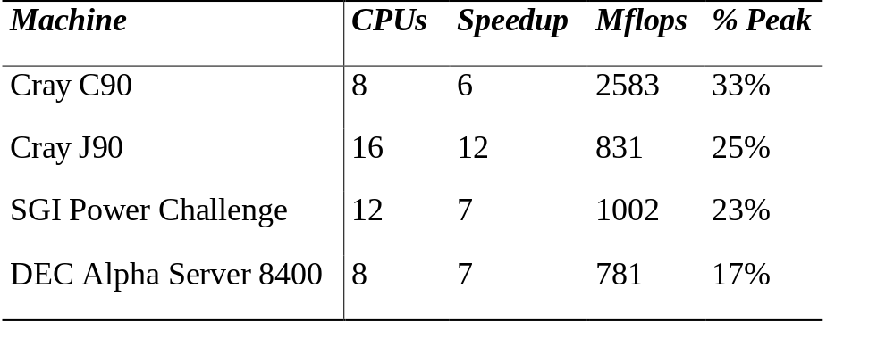
SuperLU-MT Performance Highlight (1999)
3-D flow calculation (matrix EX11, order 16614):

Slide 73
Left-looking Column LU Factorization
j
for column j = 1 to n do
  solve
  pivot: swap u_{jj} and an elt of l_{j}
  scale: l_{j} = l_{j} / u_{jj}
U
( )
( )
L 0
L I
u_{j}
l_{j}
L
= a_{j} for u_{j}, l_{j}
A
L
Column j of A becomes column j of L and U

Slide 74
Symmetric-pattern multifrontal factorization
1
4
G(A)
7
3
6
1
2
3
4
5
6
7
8
9
8
1
2
2
5
9
3
4
5
6
9
7
T(A)
8
8
7
9
3
6
A
1
2
4
5

Slide 75
Symmetric-pattern multifrontal factorization
1
4
For each node of T from leaves to root:
  Sum own row/col of A with children’s Update matrices into Frontal matrix
  Eliminate current variable from Frontal matrix, to get Update matrix
  Pass Update matrix to parent
G(A)
7
3
6
8
2
5
9
9
T(A)
8
7
3
6
1
2
4
5

Slide 76
Symmetric-pattern multifrontal factorization
1
4
For each node of T from leaves to root:
  Sum own row/col of A with children’s Update matrices into Frontal matrix
  Eliminate current variable from Frontal matrix, to get Update matrix
  Pass Update matrix to parent
G(A)
7
3
6
8
2
5
9
9
T(A)
8
1
3
7
3
7
1
3
7
3
7
3
6
7
1
2
4
5
F₁ = A₁
=> U₁

Slide 77
Symmetric-pattern multifrontal factorization
1
4
For each node of T from leaves to root:
  Sum own row/col of A with children’s Update matrices into Frontal matrix
  Eliminate current variable from Frontal matrix, to get Update matrix
  Pass Update matrix to parent
G(A)
7
3
6
8
2
5
9
9
T(A)
8
1
3
7
3
7
2
3
9
3
9
1
3
2
3
7
3
3
7
9
3
6
7
9
1
2
4
5
F₁ = A₁
=> U₁
F₂ = A₂
=> U₂

Slide 78
Symmetric-pattern multifrontal factorization
1
4
G(A)
7
3
7
8
9
3
6
3
7
8
9
8
7
7
2
5
8
9
8
9
9
F₃ = A₃+U₁+U₂
=> U₃
9
T(A)
8
1
3
7
3
7
2
3
9
3
9
1
3
2
3
7
3
3
7
9
3
6
7
9
1
2
4
5
F₁ = A₁
=> U₁
F₂ = A₂
=> U₂

Slide 79
Symmetric-pattern multifrontal factorization
1
4
G⁺(A)
7
3
6
1
2
3
4
5
6
7
8
9
8
1
2
2
5
9
3
4
5
6
9
7
T(A)
8
8
7
9
3
6
L+U
1
2
4
5

Slide 80
Symmetric-pattern multifrontal factorization
1
4
Really uses supernodes, not nodes
All arithmetic happens on
dense square matrices.
Needs extra memory for a stack of pending update matrices
Potential parallelism:
  between independent tree branches
  parallel dense ops on frontal matrix
G(A)
7
3
6
8
2
5
9
9
T(A)
8
7
3
6
1
2
4
5

Slide 81
MUMPS: distributed-memory multifrontal
[Amestoy, Duff, L’Excellent, Koster, Tuma]
Symmetric-pattern multifrontal factorization
Parallelism both from tree and by sharing dense ops
Dynamic scheduling of dense op sharing
Symmetric preordering
For nonsymmetric matrices:
  optional weighted matching for heavy diagonal
  expand nonzero pattern to be symmetric
  numerical pivoting only within supernodes if possible
  (doesn’t change pattern)
  failed pivots are passed up the tree in the update matrix

Slide 82
SuperLU-dist: GE with static pivoting [Li, Demmel]
Target: Distributed-memory multiprocessors
Goal: No pivoting during numeric factorization

Slide 83
SuperLU-dist: Distributed static data structure
0
1
2
0
1
2
0
3
4
5
3
4
5
3
0
1
2
0
1
2
0
1
2
0
U
3
4
5
3
4
5
3
4
5
3
0
1
2
0
1
2
0
L
Process(or) mesh
3
4
5
3
4
5
3
0
1
2
0
1
2
0
Block cyclic matrix layout

Slide 84
GESP:
Gaussian elimination with static pivoting
P
=
x
PA = LU
Sparse, nonsymmetric A
P is chosen numerically in advance, not by partial pivoting!
After choosing P, can permute PA symmetrically for sparsity:
Q(PA)Q^{T} = LU

Slide 85
SuperLU-dist: GE with static pivoting [Li, Demmel]
Target: Distributed-memory multiprocessors
Goal: No pivoting during numeric factorization
Permute A unsymmetrically to have large elements on the diagonal (using weighted bipartite matching)
Scale rows and columns to equilibrate
Permute A symmetrically for sparsity
Factor A = LU with no pivoting, fixing up small pivots:
  if |a_{ii}| < ε · ||A|| then replace a_{ii} by ±ε^{1/2} · ||A||
Solve for x using the triangular factors: Ly = b, Ux = y
Improve solution by iterative refinement

Slide 86
SuperLU-dist: GE with static pivoting [Li, Demmel]
Target: Distributed-memory multiprocessors
Goal: No pivoting during numeric factorization
Permute A unsymmetrically to have large elements on the diagonal (using weighted bipartite matching)
Scale rows and columns to equilibrate
Permute A symmetrically for sparsity
Factor A = LU with no pivoting, fixing up small pivots:
  if |a_{ii}| < ε · ||A|| then replace a_{ii} by ±ε^{1/2} · ||A||
Solve for x using the triangular factors: Ly = b, Ux = y
Improve solution by iterative refinement

Slide 87
Row permutation for heavy diagonal [Duff, Koster]
1
2
3
4
5
1
2
3
4
5
1
1
1
4
2
2
2
5
3
3
3
3
4
1
5
4
4
2
A
5
5
PA
Represent A as a weighted, undirected bipartite graph (one node for each row and one node for each column)
Find matching (set of independent edges) with maximum product of weights
Permute rows to place matching on diagonal
Matching algorithm also gives a row and column scaling
to make all diag elts =1 and all off-diag elts <=1

Slide 88
SuperLU-dist: GE with static pivoting [Li, Demmel]
Target: Distributed-memory multiprocessors
Goal: No pivoting during numeric factorization
Permute A unsymmetrically to have large elements on the diagonal (using weighted bipartite matching)
Scale rows and columns to equilibrate
Permute A symmetrically for sparsity
Factor A = LU with no pivoting, fixing up small pivots:
  if |a_{ii}| < ε · ||A|| then replace a_{ii} by ±ε^{1/2} · ||A||
Solve for x using the triangular factors: Ly = b, Ux = y
Improve solution by iterative refinement

Slide 89
SuperLU-dist: GE with static pivoting [Li, Demmel]
Target: Distributed-memory multiprocessors
Goal: No pivoting during numeric factorization
Permute A unsymmetrically to have large elements on the diagonal (using weighted bipartite matching)
Scale rows and columns to equilibrate
Permute A symmetrically for sparsity
Factor A = LU with no pivoting, fixing up small pivots:
  if |a_{ii}| < ε · ||A|| then replace a_{ii} by ±ε^{1/2} · ||A||
Solve for x using the triangular factors: Ly = b, Ux = y
Improve solution by iterative refinement

Slide 90
SuperLU-dist: GE with static pivoting [Li, Demmel]
Target: Distributed-memory multiprocessors
Goal: No pivoting during numeric factorization
Permute A unsymmetrically to have large elements on the diagonal (using weighted bipartite matching)
Scale rows and columns to equilibrate
Permute A symmetrically for sparsity
Factor A = LU with no pivoting, fixing up small pivots:
  if |a_{ii}| < ε · ||A|| then replace a_{ii} by ±ε^{1/2} · ||A||
Solve for x using the triangular factors: Ly = b, Ux = y
Improve solution by iterative refinement

Slide 91
SuperLU-dist: GE with static pivoting [Li, Demmel]
Target: Distributed-memory multiprocessors
Goal: No pivoting during numeric factorization
Permute A unsymmetrically to have large elements on the diagonal (using weighted bipartite matching)
Scale rows and columns to equilibrate
Permute A symmetrically for sparsity
Factor A = LU with no pivoting, fixing up small pivots:
  if |a_{ii}| < ε · ||A|| then replace a_{ii} by ±ε^{1/2} · ||A||
Solve for x using the triangular factors: Ly = b, Ux = y
Improve solution by iterative refinement

Slide 92
Iterative refinement to improve solution
Iterate:
r = b – A*x
backerr = max_{i} ( r_{i} / (|A|*|x| + |b|)_{i} )
if backerr < ε or backerr > lasterr/2 then stop iterating
solve L*U*dx = r
x = x + dx
lasterr = backerr
repeat
Usually 0 – 3 steps are enough

Slide 93
Convergence analysis of iterative refinement
Let C = I – A(LU)⁻¹ [ so A = (I – C)·(LU) ]
x₁ = (LU)⁻¹b
r₁ = b – Ax₁ = (I – A(LU)⁻¹)b = Cb
dx₁ = (LU)⁻¹ r₁ = (LU)⁻¹Cb
x₂ = x₁+dx₁ = (LU)⁻¹(I + C)b
r₂ = b – Ax₂ = (I – (I – C)·(I + C))b = C²b
. . .
In general, r_{k} = b – Ax_{k} = C^{k}b
Thus r_{k} → 0 if |largest eigenvalue of C| < 1.

Slide 94
SuperLU-dist: GE with static pivoting [Li, Demmel]
Target: Distributed-memory multiprocessors
Goal: No pivoting during numeric factorization
Permute A unsymmetrically to have large elements on the diagonal (using weighted bipartite matching)
Scale rows and columns to equilibrate
Permute A symmetrically for sparsity
Factor A = LU with no pivoting, fixing up small pivots:
  if |a_{ii}| < ε · ||A|| then replace a_{ii} by ±ε^{1/2} · ||A||
Solve for x using the triangular factors: Ly = b, Ux = y
Improve solution by iterative refinement

Slide 95
Directed graph
1
2
4
7
5
3
6
A
G(A)
A is square, unsymmetric, nonzero diagonal
Edges from rows to columns
Symmetric permutations PAP^{T}

Slide 96
Undirected graph, ignoring edge directions
1
2
4
7
5
3
6
A+A^{T}
G(A+A^{T})
Overestimates the nonzero structure of A
Sparse GESP can use symmetric permutations (min degree, nested dissection) of this graph

Slide 97
Symbolic factorization of undirected graph
1
2
4
7
5
3
6
chol(A +A^{T})
G⁺(A+A^{T})
Overestimates the nonzero structure of L+U

Slide 98
Symbolic factorization of directed graph
1
2
4
7
5
3
6
A
+
L+U
G (A)
Add fill edge a -> b if there is a path from a to b through lower-numbered vertices.
Sparser than G⁺(A+A^{T}) in general.
But what’s a good ordering for G⁺(A)?

Slide 99
Question: Preordering for GESP
Use directed graph model,
less well understood than symmetric factorization
  Symmetric: bottom-up, top-down, hybrids
  Nonsymmetric: mostly bottom-up
  Symmetric: best ordering is NP-complete, but approximation theory is based on graph partitioning (separators)
  Nonsymmetric: no approximation theory is known;
  partitioning is not the whole story
Good approximations and efficient algorithms
both remain to be discovered

Slide 100
Remarks on nonsymmetric GE
Multifrontal tends to be faster but use more memory
Unsymmetric-pattern multifrontal
  Lots more complicated, not simple elimination tree
  Sequential and SMP versions in UMFpack and WSMP (see web links)
  Distributed-memory unsymmetric-pattern multifrontal is a research topic
Combinatorial preliminaries are important: ordering, etree, symbolic factorization, matching, scheduling
  not well understood in many ways
  also, mostly not done in parallel
Not mentioned: symmetric indefinite problems
Direct-methods technology is also used in preconditioners for iterative methods

Slide 101
Matching and block triangular form
Dulmage-Mendelsohn decomposition:
  Bipartite matching followed by strongly connected components
Square A with nonzero diagonal:
  [p, p, r] = dmperm(A);
  connected components of an undirected graph
  strongly connected components of a directed graph
Square, full rank A:
  [p, q, r] = dmperm(A);
  A(p,q) has nonzero diagonal and is in block upper triangular form
Arbitrary A:
  [p, q, r, s] = dmperm(A);
  maximum-size matching in a bipartite graph
  minimum-size vertex cover in a bipartite graph
  decomposition into strong Hall blocks

Slide 102
Directed graph
1
2
4
7
5
3
6
A
G(A)
A is square, unsymmetric, nonzero diagonal
Edges from rows to columns
Symmetric permutations PAP^{T} renumber vertices

Slide 103
Strongly connected components
1
2
4
7
5
3
6
1
1
2
2
4
7
4
7
5
5
3
6
3
6
PAP^{T}
G(A)
Symmetric permutation to block triangular form
Diagonal blocks are Strong Hall (irreducible / strongly connected)
Find P in linear time by depth-first search [Tarjan]
Row and column partitions are independent of choice of nonzero diagonal
Solve Ax=b by block back substitution

Slide 104
Solving A*x = b in block triangular form
% Permute A to block form
[p,q,r] = dmperm(A);
A = A(p,q); x = b(p);
% Block backsolve
nblocks = length(r) – 1;
for k = nblocks : –1 : 1
% Indices above the k-th block
I = 1 : r(k) – 1;
% Indices of the k-th block
J = r(k) : r(k+1) – 1;
x(J) = A(J,J) \ x(J);
x(I) = x(I) – A(I,J) * x(J);
end;
% Undo the permutation of x
x(q) = x;
1
2
3
4
5
6
7
1
2
3
4
=
5
6
7
A
x
b

Slide 105
Bipartite matching: Permutation to nonzero diagonal
1
2
3
4
5
1
2
3
4
5
1
1
1
4
2
2
2
5
3
3
3
3
4
1
5
4
4
2
A
5
5
PA
Represent A as an undirected bipartite graph (one node for each row and one node for each column)
Find perfect matching: set of edges that hits each vertex exactly once
Permute rows to place matching on diagonal

Slide 106
Strong Hall comps are independent of matching
1
2
4
7
5
3
6
1
1
22
1
11
2
2
2
4
3
3
4
4
44
77
55
7
5
5
5
3
6
6
6
33
66
7
7
1
2
4
7
5
3
6
1
1
4
41
12
2
2
1
7
3
3
74
2
4
4
27
55
5
5
5
6
6
6
3
63
36
7
7

Slide 107
Dulmage-Mendelsohn Theory
A. L. Dulmage & N. S. Mendelsohn. “Coverings of bipartite graphs.” Can. J. Math. 10: 517-534, 1958.
A. L. Dulmage & N. S. Mendelsohn. “The term and stochastic ranks of a matrix.” Can. J. Math. 11: 269-279, 1959.
A. L. Dulmage & N. S. Mendelsohn. “A structure theory of bipartite graphs of finite exterior dimension.” Trans. Royal Soc. Can., ser. 3, 53: 1-13, 1959.
D. M. Johnson, A. L. Dulmage, & N. S. Mendelsohn. “Connectivity and reducibility of graphs.” Can. J. Math. 14: 529-539, 1962.
A. L. Dulmage & N. S. Mendelsohn. “Two algorithms for bipartite graphs.” SIAM J. 11: 183-194, 1963.
A. Pothen & C.-J. Fan. “Computing the block triangular form of a sparse matrix.” ACM Trans. Math. Software 16: 303-324, 1990.

Slide 108
dmperm: Matching and block triangular form
Dulmage-Mendelsohn decomposition:
  Bipartite matching followed by strongly connected components
Square A with nonzero diagonal:
  [p, p, r] = dmperm(A);
  connected components of an undirected graph
  strongly connected components of a directed graph
Square, full rank A:
  [p, q, r] = dmperm(A);
  A(p,q) has nonzero diagonal and is in block upper triangular form
Arbitrary A:
  [p, q, r, s] = dmperm(A);
  maximum-size matching in a bipartite graph
  minimum-size vertex cover in a bipartite graph
  decomposition into strong Hall blocks

Slide 109
Hall and strong Hall properties
Let G be a bipartite graph with m “row” vertices and n “column” vertices.
A matching is a set of edges of G with no common endpoints.
G has the Hall property if for all k >= 0, every set of k columns is adjacent to at least k rows.
Hall’s theorem: G has a matching of size n iff G has the Hall property.
G has the strong Hall property if for all k with 0 < k < n, every set
of k columns is adjacent to at least k+1 rows.

Slide 110
Alternating paths
Let M be a matching. An alternating walk is a sequence of edges with every second edge in M. (Vertices or edges may appear more than once in the walk.) An alternating tour is an alternating walk whose endpoints are the same. An alternating path is an alternating walk with no repeated vertices. An alternating cycle is an alternating tour with no repeated vertices except its endpoint.
Lemma. Let M and N be two maximum matchings. Their symmetric difference (M∪N) – (M∩N) consists of vertex-disjoint components, each of which is either
  an alternating cycle in both M and N, or
  an alternating path in both M and N from an
  M-unmatched column to an N-unmatched column, or
  same as 2 but for rows.

Slide 111
Dulmage-Mendelsohn decomposition (coarse)
Let M be a maximum-size matching. Define:
VR = { rows reachable via alt. path from some unmatched row }
VC = { cols reachable via alt. path from some unmatched row }
HR = { rows reachable via alt. path from some unmatched col }
HC = { cols reachable via alt. path from some unmatched col }
SR = R – VR – HR
SC = C – VC – HC

Slide 112
Dulmage-Mendelsohn decomposition
1
1
2
3
4
5
6
7
8
9
10
11
2
1
1
3
2
HR
2
4
HC
3
3
5
4
5
4
6
6
5
7
SR
SC
7
6
8
8
7
9
9
8
10
10
11
VR
9
11
VC
12
10
11
12

Slide 113
Dulmage-Mendelsohn theory
Theorem 1. VR, HR, and SR are pairwise disjoint.
VC, HC, and SC are pairwise disjoint.
Theorem 2. No matching edge joins xR and yC if x and y are different.
Theorem 3. No edge joins VR and SC, or VR and HC, or SR and HC.
Theorem 4. SR and SC are perfectly matched to each other.
Theorem 5. The subgraph induced by VR and VC has the
strong Hall property. The transpose of the subgraph
induced by HR and HC has the strong Hall property.
Theorem 6. The vertex sets VR, HR, SR, VC, HC, SC are
independent of the choice of maximum matching M.

Slide 114
Dulmage-Mendelsohn decomposition (fine)
Consider the perfectly matched square block induced by SR and SC. In the sequel we shall ignore VR, VC, HR, and HC. Thus, G is a bipartite graph with n row vertices and n column vertices, and G has a perfect matching M.
Call two columns equivalent if they lie on an alternating tour. This is an equivalence relation; let the equivalence classes be C₁, C₂, . . ., C_{p}. Let R_{i} be the set of rows matched to C_{i}.

Slide 115
The fine Dulmage-Mendelsohn decomposition
Matrix A
1
2
3
4
5
6
7
1
1
1
2
2
2
3
R₁
C₁
4
3
3
5
6
4
4
7
R₂
5
5
C₂
6
6
Directed graph
G(A)
R₃
C₃
1
2
7
7
Bipartite graph H(A)
3
4
5
6
3

Slide 116
Dulmage-Mendelsohn theory
Theorem 7. The R_{i}’s and the C_{j}’s can be renumbered so no edge
joins R_{i} and C_{j} if i > j.
Theorem 8. The subgraph induced by R_{i} and C_{i} has the strong Hall property.
Theorem 9. The partition R₁∪C₁ , R₂∪C₂ , . . ., R_{p}∪C_{p} is independent of the
choice of maximum matching.
Theorem 10. If non-matching edges are directed from rows to columns and
matching edges are shrunk into single vertices, the resulting directed graph
G(A) has strongly connected components C₁ , C₂ , . . ., C_{p}.
Theorem 11. A bipartite graph G has the strong Hall property
iff every pair of edges of G is on some alternating tour
iff G is connected and every edge of G is in some perfect matching.
Theorem 12. Given a square matrix A, if we permute rows and columns to get
a nonzero diagonal and then do a symmetric permutation to put the strongly
connected components into topological order (i.e. in block triangular form),
then the grouping of rows and columns into diagonal blocks is independent
of the choice of nonzero diagonal.

Slide 117
Strongly connected components are independent of choice of perfect matching
1
2
4
7
5
3
6
1
1
22
1
11
2
2
2
4
3
3
4
4
44
77
55
7
5
5
5
3
6
6
6
33
66
7
7
1
2
4
7
5
3
6
1
1
4
41
12
2
2
1
7
3
3
2
4
4
74
27
55
5
5
5
6
6
6
3
63
36
7
7

Slide 118
Matrix terminology
Square matrix A is irreducible if there does not exist any permutation matrix P such that PAP^{T} has a nontrivial block triangular form [A₁₁ A₁₂ ; 0 A₂₂].
Square matrix A is fully indecomposable if there do not exist any permutation matrices P and Q such that PAQ^{T} has a nontrivial block triangular form [A₁₁ A₁₂ ; 0 A₂₂].
Fully indecomposable implies irreducible, not vice versa.
Fully indecomposable = square and strong Hall.
A square matrix with nonzero diagonal is irreducible iff fully indecomposable iff strong Hall iff strongly connected.

Slide 119
Applications of D-M decomposition
Permutation to block triangular form for Ax=b
Connected components of undirected graphs
Strongly connected components of directed graphs
Minimum-size vertex cover for bipartite graphs
Extracting vertex separators from edge cuts
for arbitrary graphs
For strong Hall matrices, several upper bounds in nonzero structure prediction are best possible:
  Column intersection graph factor is R in QR
  Column intersection graph factor is tight bound on U in PA=LU
  Row merge graph is tight bound on Lbar and U in PA=LU

